Slide 1


MICROSOFT EMS COMMUNITY
WELCOME TO
TALK NAME
TAG LINE
WED · DATE
Intune · Entra ID · Defender · Purview (Select Subject as Appropriate)
Talk by [SPEAKER NAME]

Slide 2


TODAY'S SPEAKER
NAME
JOB TITLE
BLURB
WEBSITES
Hosted by Microsoft EMS Discord Staff Team
Microsoft EMS Community · September 2026
2

Slide 3



3 Vertical Box Format
TEXT
TEXT
TEXT
TEXT
TEXT
TEXT
TEXT
Microsoft EMS Community · September 2026
3

Slide 4

6 Box Format
1
TITLE
4
TITLE
Text
TEXT
2
Title
5
TITLE
TEXT
TEXT
3
TITLE
6
TITLE
TEXT
TEXT
Microsoft EMS Community · September 2026
7

Slide 5



3 Box Vertical Stacked
TITLE
TITLE
TITLE
TEXT
TEXT
TEXT
TEXT
TEXT
TEXT
TEXT
TEXT
TEXT
TEXT
TEXT
TEXT
TEXT
TEXT
TEXT
TEXT
TEXT
TEXT
TEXT
TEXT
TEXT
Text
TEXT
TEXT
Microsoft EMS Community · September 2026
8

Slide 6


Bullet Point Format
Bullet Point Format
Point 1
TEXT
TEXT
TEXT
Point 2
TEXT
TEXT
Point 3
TEXT
TEXT
TEXT
Point 4
TEXT
SUBTEXT
Microsoft EMS Community · September 2026
13

Slide 7
Blank Slide
Sub Text
Microsoft EMS Community · September 2026
10

Slide 8
QUIZ
QUIZ FORMAT
Microsoft EMS Community · September 2026
20

Slide 9
MICROSOFT EMS COMMUNITY
Thank you
aka.ms/M365EMSDiscord
msems.community
Independent and community-run. Not affiliated with, endorsed by, or sponsored by Microsoft. Product names are trademarks of the Microsoft group of companies.
Notes:
Wrap up. Discord https://aka.ms/M365EMSDiscord and https://www.msems.community/

Slide 10
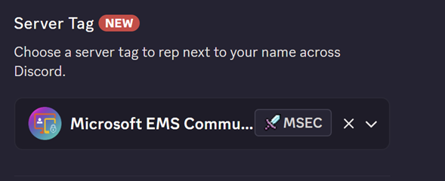
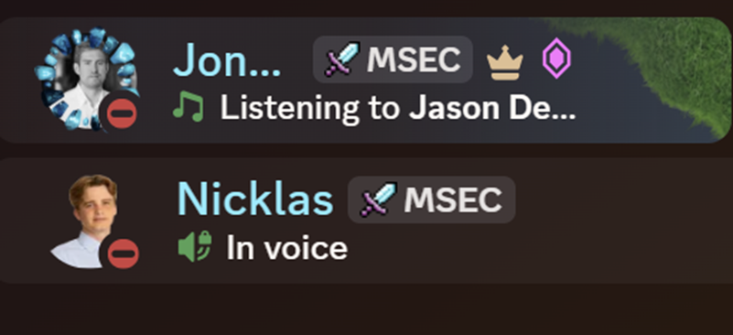
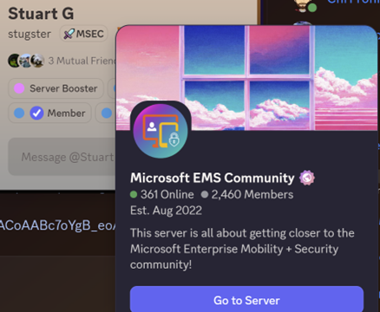
REP THE COMMUNITY
Add the MSEC server tag
1
Open Discord, then your profile
Click your name bottom-left, then Edit Profile.
2
Choose Server Tag
Pick Microsoft EMS Community from the list.
3
Wear it everywhere
The MSEC tag shows next to your name across Discord.
CloudHour · Microsoft EMS Community · Jul 2026
6
Notes:
Set the Microsoft EMS Community server tag in Discord. Join: https://aka.ms/M365EMSDiscord

